Slide 1
Matter and radiation

Slide 2
Do Now:
List as many forces as you can think of. Categorise the forces in any way you choose

Slide 3
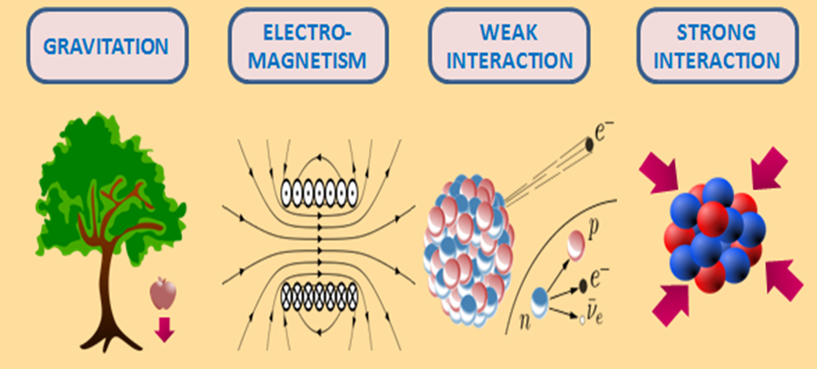
Forces

Slide 4
Objectives
Describe what is meant by an interaction. Name different types of interaction. Explain what makes charged particles attract or repel each other. Describe an exchange particle.

Slide 5
The fundamental forces
There are 4 fundamental forces:
Electromagnetic
Strong nuclear force
Weak nuclear force
Gravity

Slide 6
Electromagnetic force
What is a force?
A force is an interaction that results in a change:
in direction, in shape, in speed
So we can see that an object can have its momentum altered by an interacting force on the object.
By applying Newton’s 3rd law of motion, we know that when two objects interact, they will exert equal and opposite forces on each other. When this happens, momentum must be conserved and is therefore, transferred between the objects by these forces, if no other forces act on them.

Slide 7
Electromagnetic force
Okay then,
Imagine we have two electrons:
We can see that they are electrons as they are negative….
But, the question is this: How do the electrons know to repel each other??

Slide 8
Electromagnetic force
Okay then,
Imagine we have two electrons:
So we say that the interaction is carried by a particle that is exchanged between the electrons. This interaction causes the electrons to repel, with equal and opposite force on them. The force is an electromagnetic force.

Slide 9
Feynman diagrams
For example, if two protons came close to each other, they would repel each other due to both having the exact same charge.
Richard Feynman said the electromagnetic force between two charged objects is due to the exchange of virtual photons.
Feynman diagrams help us to illustrate and understand the interactions between particles and the exchange particles involved.
time
p – proton
Ɣ – virtual photon

Slide 10
Feynman diagrams
Note: virtual photons are real particles, they have been discovered, but they only exist for a very short period of time.
They only effect the electromagnetic force.
This diagram shows the passage of time, upwards.
time
time
p – proton
Ɣ – virtual photon

Slide 11
Feynman diagrams
Let’s show our repulsion of the two electrons on a Feynman Diagram
The interaction of the two electrons must have been caused by something. That something is the exchange of the gauge boson, the virtual photon
Ɣ
time

Slide 12
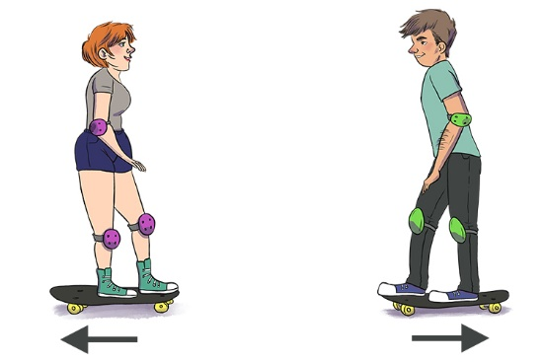
An interaction model
How can we represent forces that act at a distance?
The diagram shows two skateboarders facing each other.
If one of them throws a ball at the other what happens?
The person throwing the ball would recoil in the other direction.
The person catching the ball would recoil in the opposite direction to the first person.
This ensures that momentum is conserved in the interaction.
This is similar, to the exchange of a virtual photon in the interaction between two like-charged particles.
The big problem is, we cannot detect the virtual photon!

Slide 13

An interaction model
For two oppositely charged particles, this ball analogy does not work.
If instead, we use the idea of the thrower, throwing a boomerang, this would ensure that momentum is conserved!
This would cause the oppositely charged particles to attract!

Slide 14
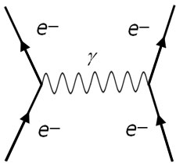
Virtual Photons
The virtual photon is an exchange particle that can pass between, and influence, any charged particles.
A-level students need to draw particle diagrams to show these.
Two electrons approach each other and then are repelled so they then change direction as a virtual photon passes between them.

Slide 15
The weak nuclear force
The nucleons, protons and neutrons in the nucleus, are held together by the strong nuclear force, giving the nucleus stability.
The strong nuclear force is not involved in β⁻ decay or β⁺ decay.
The neutron has zero charge, so the electromagnetic force cannot be the cause of β⁻ decay or β⁺ decay.
The force that is involved with these nuclear changes is called the weak nuclear force.

Slide 16
The weak nuclear force
During both β⁻ decay and β⁺ decay, a new particle and a new antiparticle are created.
The unusual thing is these are not a particle and its antiparticle pairs, as in pair production!
Instead, we get a particle - an electron (β⁻) and an antineutrino,
OR
we get an antiparticle - a positron (β⁺) and a neutrino.
Neutrinos and antineutrinos have zero charge and very little mass. They rarely interact with other particles, but some interactions can occur.

Slide 17
The weak nuclear force
Exchange particles for the neutrino or antineutrino interactions are W bosons.
Properties of W bosons:
Non-zero rest mass
No more than 0.001fm range
Positively charged (W⁺ boson) or negatively charged (W⁻ boson)
Charge is always conserved.
p
β⁻
β⁺
-
n
neutron-neutrino interaction
proton-antineutrino interaction

Slide 18
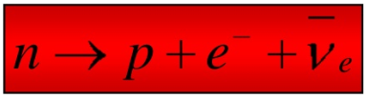
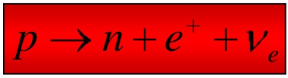
Beta decay
p
When the W boson meets a neutrino or antineutrino, it changes them into an electron or positron respectively.
Yet, a W boson can still decay, even if a neutrino or antineutrino are not present.
What might happen?
β⁻
β⁺
-
n
neutron-neutrino interaction
proton-antineutrino interaction
W⁻ boson decays to β⁻ particle and an antineutrino
W⁺ boson decays to β⁺ particle and a neutrino.
Charge is conserved in both interactions once again!

Slide 19
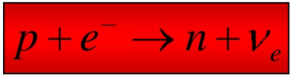
Electron capture
An electron from an inner energy level can sometimes interact, via the weak interaction, with a proton to create a neutron, in a process called electron capture.
In this process, the W⁺ boson changes the electron into a neutrino.
This can also happen with a collision of a proton and an electron at very high speeds.
e⁻
electron capture

Slide 20
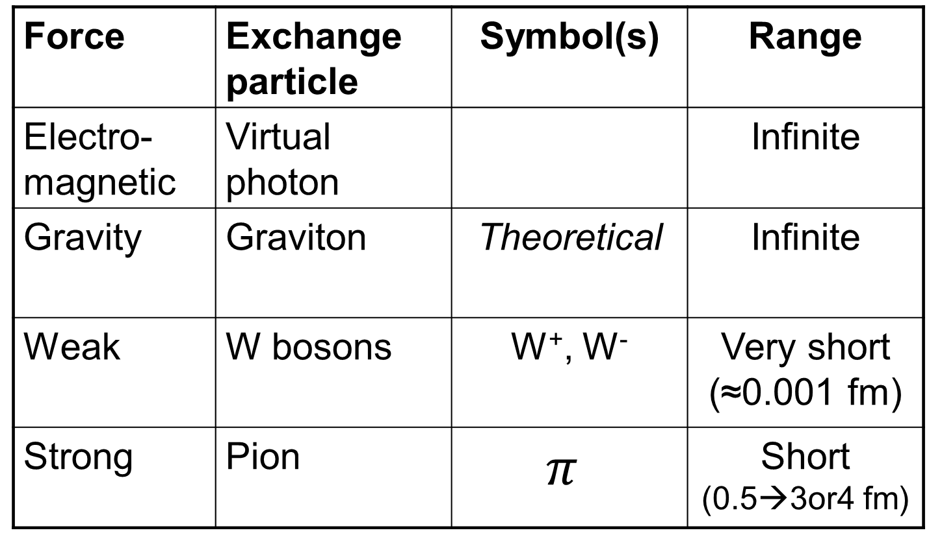
Linking exchange particles to forces
Force | Exchange particle | Symbol(s) | Range
Electro-magnetic | Virtual photon |  | Infinite
Gravity | Graviton | Theoretical | Infinite
Weak | W bosons | W⁺, W⁻ | Very short (≈0.001 fm)
Strong | Pion | $$π$$ | Short (0.5→3or4 fm)
Note: There is also a Z⁰ uncharged weak force boson but it is not needed for the A-Level course

Slide 21

Video – Feynman diagrams

Slide 22
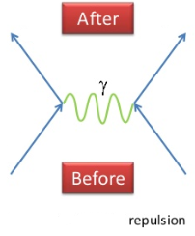
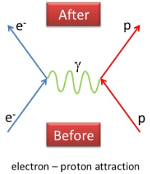
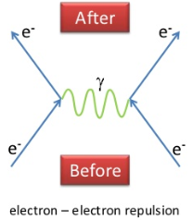
Particle interactions - Questions
a)
b)
c)
p
p
p
p
proton - proton

Slide 23
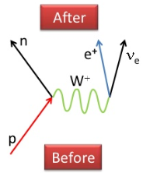
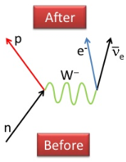
Particle interactions - Questions
a)
b)
Note: β⁺ can be written as e⁺
Note: β⁻ can be written as e⁻

Slide 24
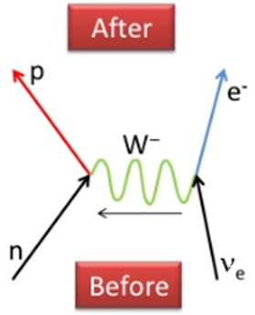
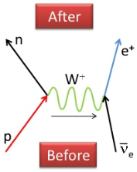
Particle interactions - Questions
a)i)
a)ii)

Slide 25
Particle interactions - Questions
W bosons have a very short range of no more than about 0.001 fm.
b) Speed = Distance(range)
Time(lifetime)
Lifetime = Range
Speed
Lifetime = 0.001x10⁻¹⁵
3.00x10⁸
Lifetime = 3.33x10⁻²⁷ s

Slide 26
Particle interactions - Questions
4 a State three differences between a W boson and a virtual photon.
b In both diagrams, a proton changes into a neutron.
Describe how these two processes differ.
The W boson is charged and the photon is uncharged.
The W boson has a non-zero rest mass and the photon has zero rest mass.
The W boson is the exchange particle of the weak nuclear force whereas the virtual photon is the exchange particle of the electromagnetic force.

Slide 27
Particle interactions - Questions
4 a State three differences between a W boson and a virtual photon.
b In both diagrams, a proton changes into a neutron.
Describe how these two processes differ.
Figure 1
Figure 2
e⁻
electron capture
In figure 1, a W⁺ boson decays into a neutrino and a β⁺ particle.
In figure 2, a W⁺ boson interacts with an electron, which turns into a neutrino.

Slide 28
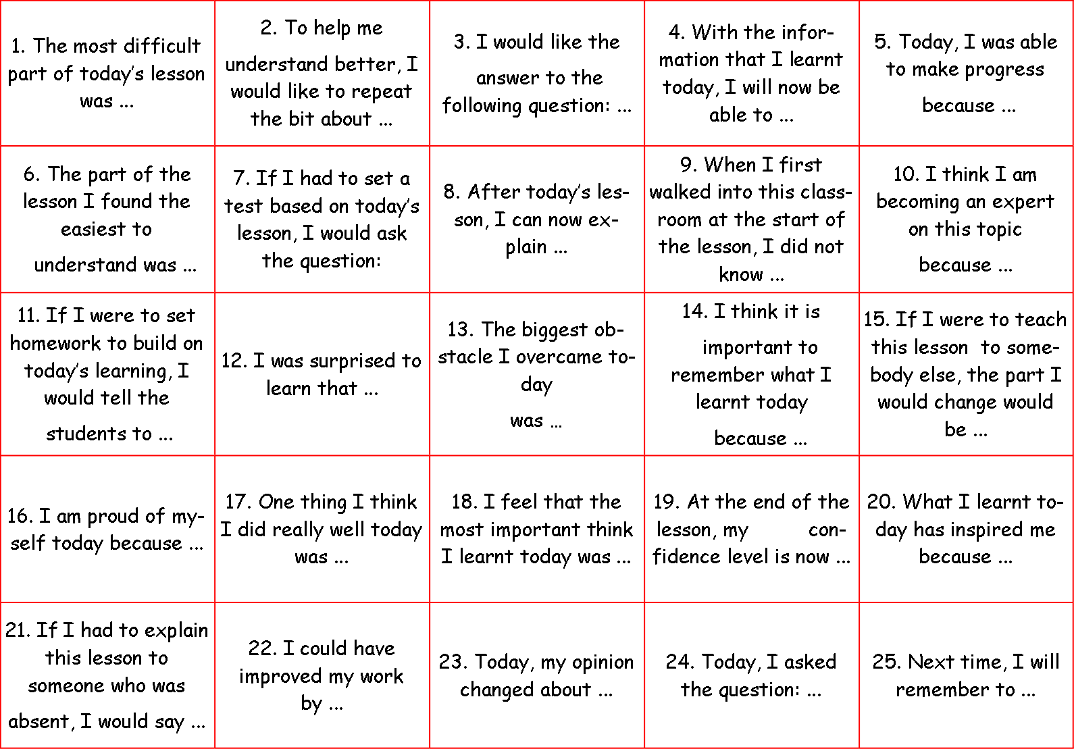
Consolidation
Select two numbers between 1-25 from the following table, write these in the margin of your book. Now complete the sentence/question from the numbers that you have chosen…

